Slide 1

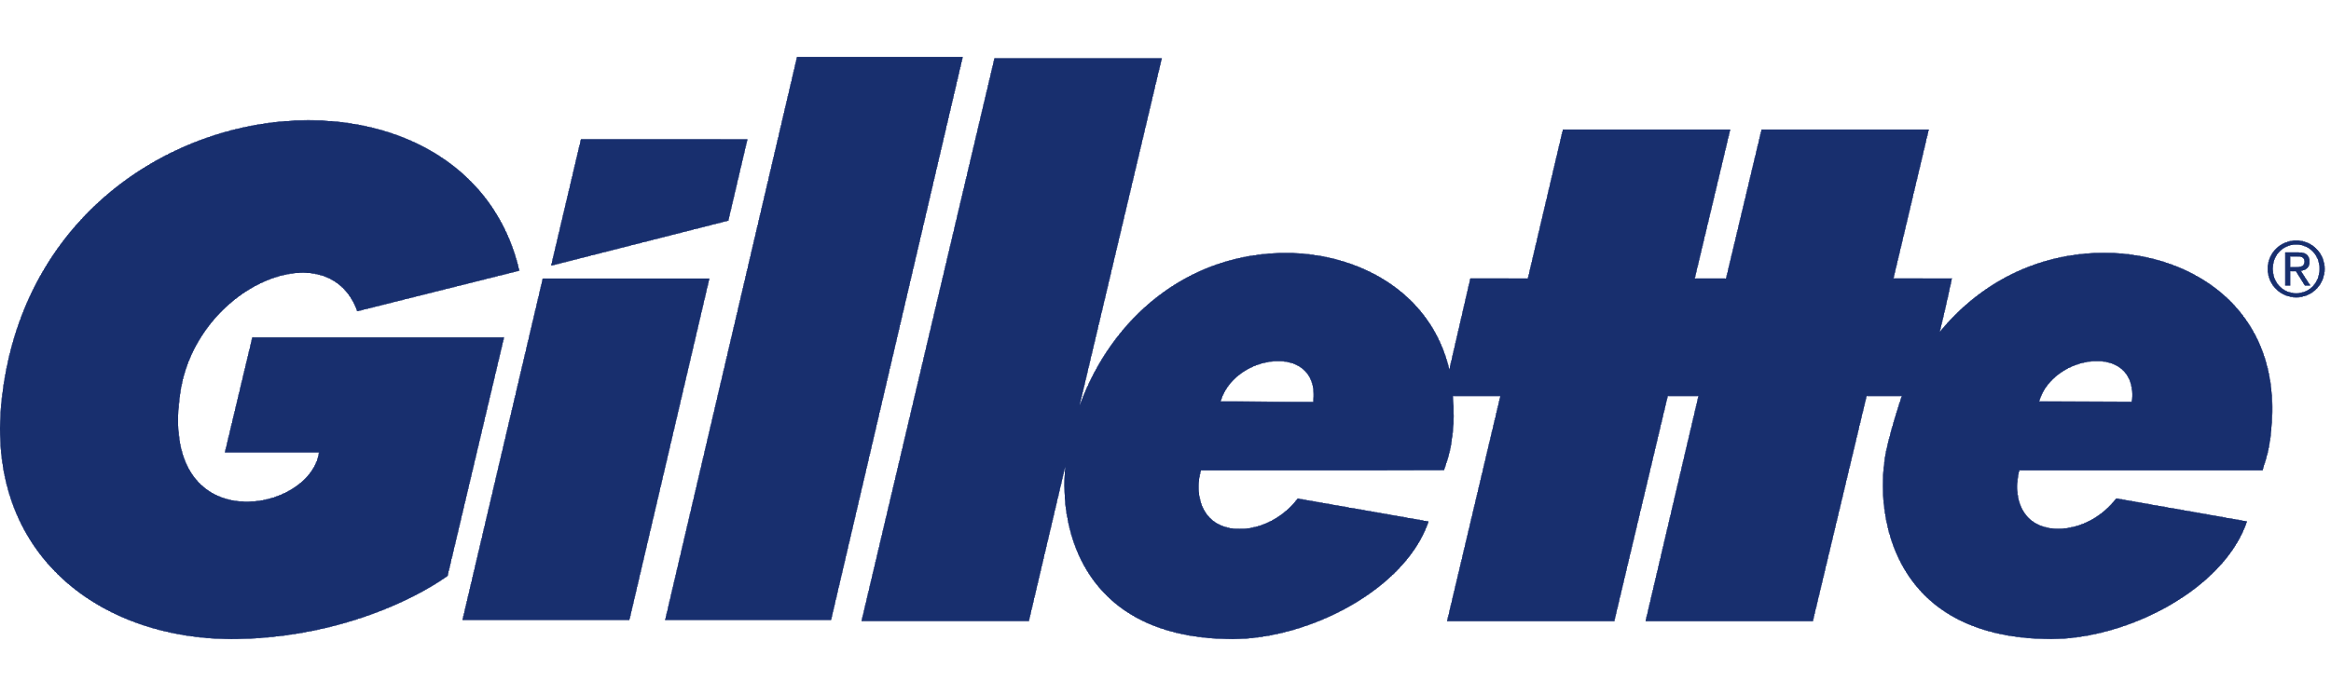
Gillette Litigation Case
Anika Abrahamson | Chelsea Alford | Lisiman Hua | Karry Lu | Joe Werthan

Slide 2
Our Recommendation
After completing our analysis, we believe Gillette should continue with the litigation instead of taking the $4.5 Million settlement. The following analysis will demonstrate why we’re making this recommendation.

Slide 3
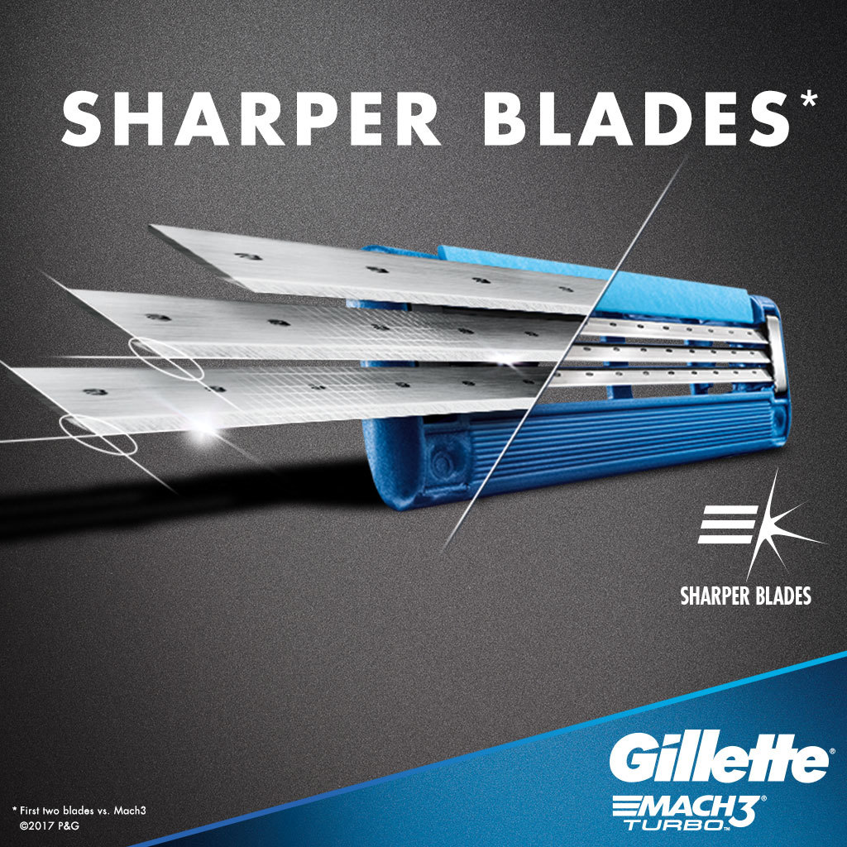
Our Analysis
Our Final Decision Tree
Sensitivity Analysis
Expected Values
Probability
Value of Information
Perfect
Imperfect
Utility Analysis

Slide 4
Final Decision Tree

Slide 5
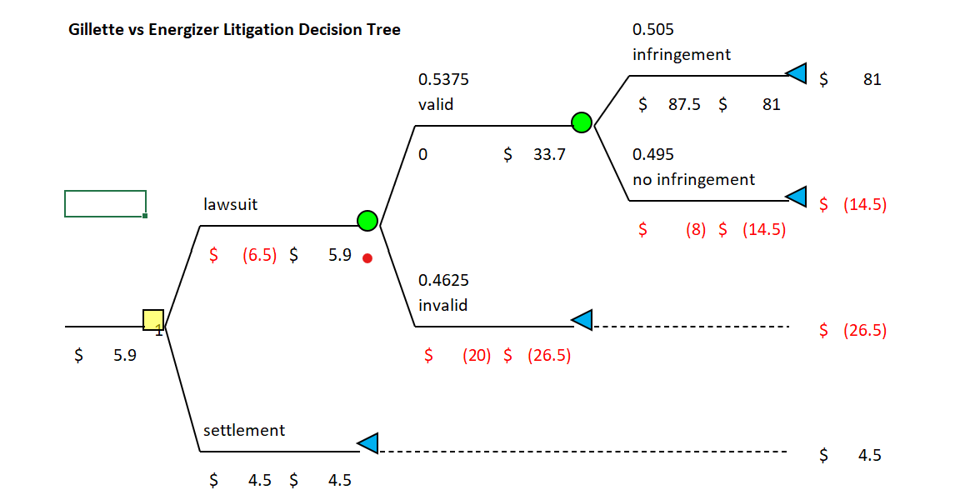
Decision Tree
Notes:
With the information our team here at Gillette has gathered thus far, our decision tree shows the expected value of pursuing the lawsuit is $5.9 million, which is greater than the settlement we’ve been offered from Energizer. From this tree alone, we believe moving forward with litigation is the correct decision, but we have done further analysis to take into account if profits and probabilities change, more perfect or imperfect information can be found, and when our company's risk tolerance is factored in.

Slide 6
Sensitivity Analysis
Expected Values

Slide 7
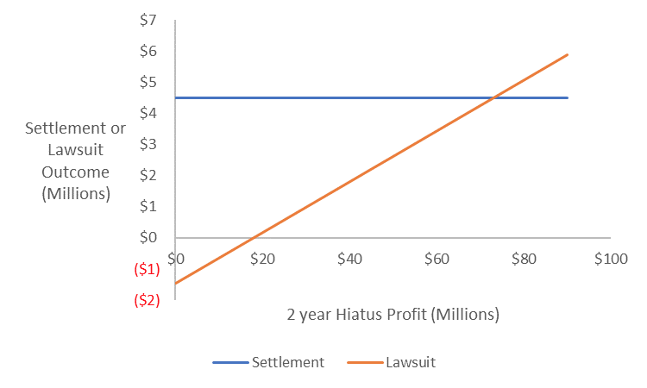
Sensitivity Analysis
Varied Possible 2 Year Hiatus From Competition Profit
$73
Notes:
We have estimated the potential profit we can gain with a hiatus from our competitors if we win the lawsuit. Depending on if Energizer has another razor that doesn’t violate Gillette's patent, or if they need to start from scratch in R&D, the current estimation of profit from a 2 year hiatus is $90 Million. Because we can’t be certain when Energizer would release a new razor, this amount is easily debatable. The sensitivity analysis shown on this graph, demonstrates that the expected value of continuing with the lawsuit equals the $4.5 million offered in the settlement when the 2 year hiatus profits decreases to $73 million.

Slide 8
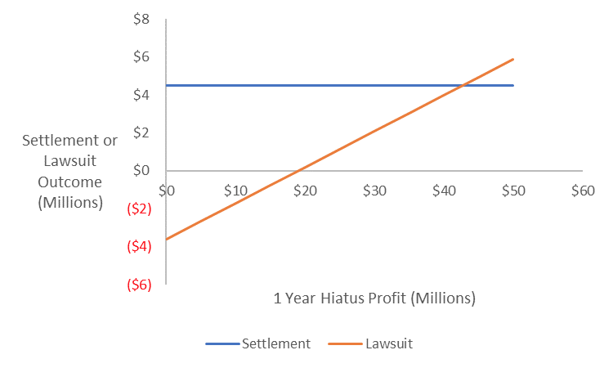
Sensitivity Analysis
Varied Possible 1 Year Hiatus From Competition Profit
$42.8
Notes:
When looking at the 1 year hiatus option, which is estimated to be $50 million in profits, a decrease to $42.8 million would change the expected value of continuing with the lawsuit equal to taking the settlement. With an over 18% decrease of the 2 year hiatus or over 14% decrease from the 1 year hiatus estimates needed to make taking the settlement the better decision, we conclude that although possible, we believe our team’s current estimations are not off by those amounts, which supports continuing with litigation.

Slide 9
Sensitivity Analysis
Probability

Slide 10
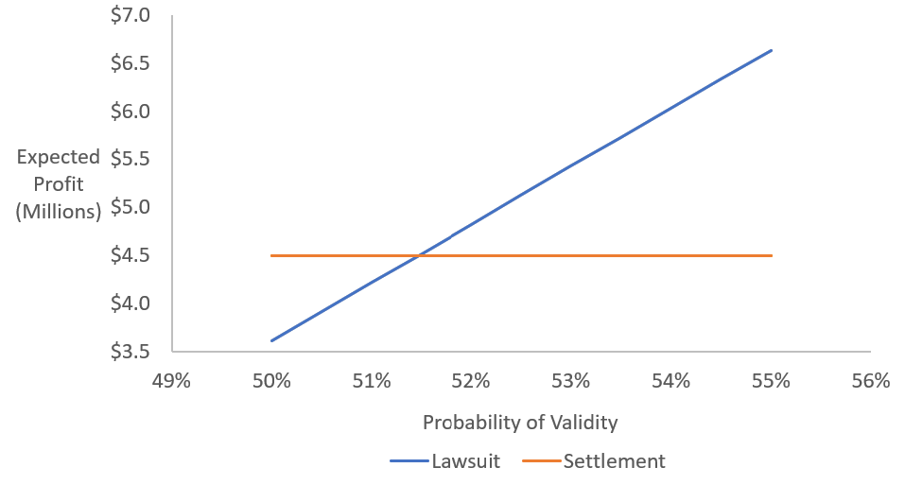
Sensitivity Analysis
Probability the jury finds Gillette’s case valid
51.5%
Notes:
Break-even probability = 51.5% valid, 48.5% invalid
With current probability of 53.75% validity, it is unlikely to fall more than 2% points.
Essentially, the odds need to be slightly better than chance to justify litigation, which our team believes we have.

Slide 11
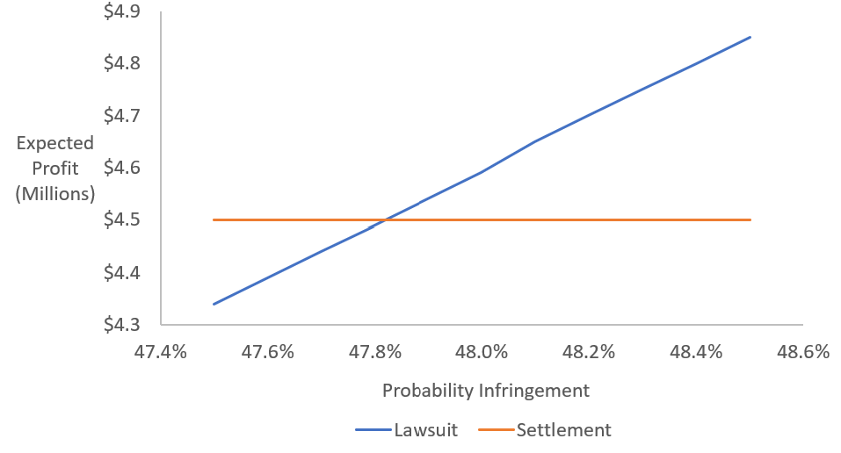
Sensitivity Analysis
Probability the jury finds infringement
47.8%
Notes:
Break-even probability = 47.8% infringement, 52.2% no infringement
With current probability of 50.5% infringement, it is unlikely to fall about 2% points.
Essentially, as long as our odds are about the same as the decision being up to chance, then it is worth it to pursue litigation. If we have a good case, which our legal team believes we do, our odds should be better than chance.

Slide 12
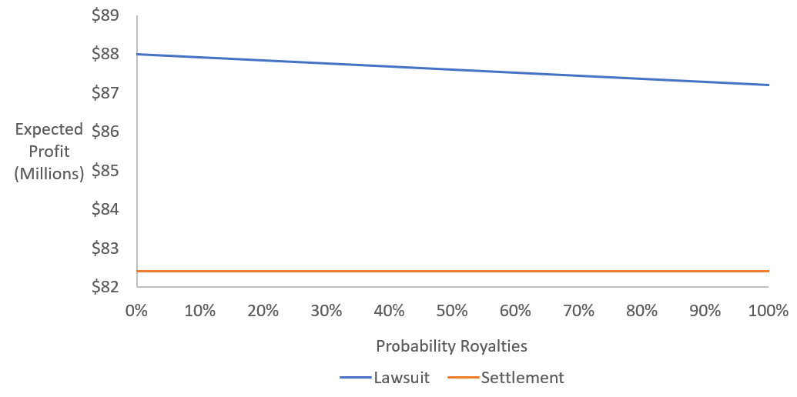
Sensitivity Analysis
Probability the judge chooses to award damages based on profits or royalties
$82.4 M
Notes:
Break-even analysis: awards must be at a minimum of $82.4 million in order to justify litigation
82.4 million is the amount of awards which would be essentially equal to the $4.5 million settlement after considering the costs and uncertainties associated with pursuing litigation.
It doesn’t matter if the judge were to choose to award damages based on royalties or profits, either way it is best to pursue litigation over taking the settlement. Therefore, if Gillette wins the case, it is inconsequential how the judge awards damages to Gillette, because the payoff will be greater than the $4.5 million settlement regardless.

Slide 13
Value of Information
Perfect Information

Slide 14
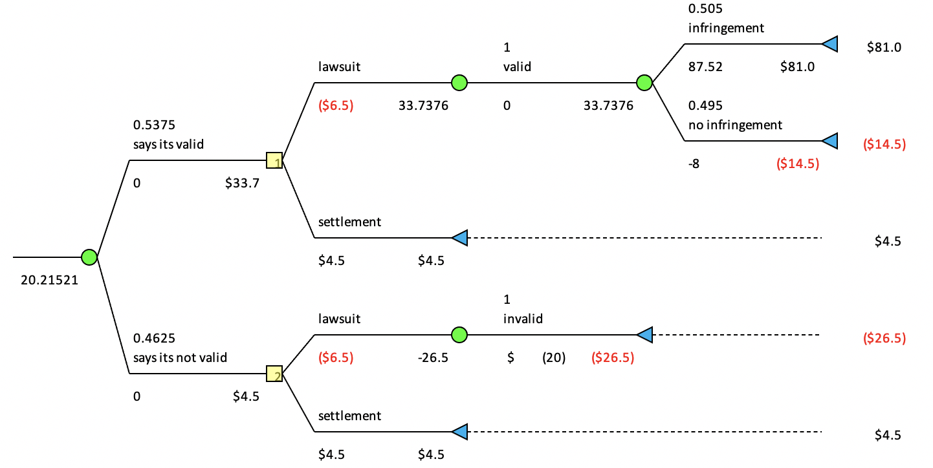
EVPI
Patent validity: $14.3M
Notes:
If any source can tell for sure that the patent is valid then Gillette should continue with lawsuit with an expected value of 33.8 million dollars. However, if credible sources tell that the jury will find the patent invalid, then Gillette should accept the settlement for 4.5 million dollar. If the information cost no more than 14.3 million dollars, it is economically reasonable to make the purchase.

Slide 15
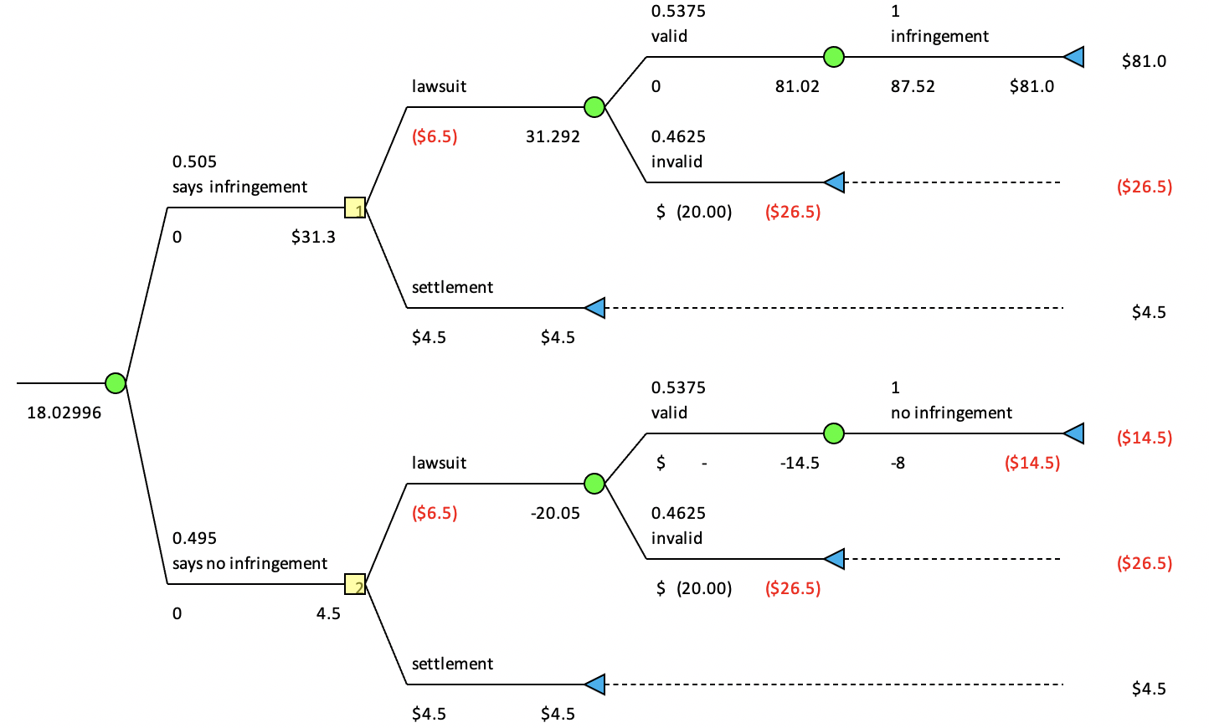
EVPI
Infringement: $12.15M
Notes:
If credible sources tell that there is certainly infringement (either literal infringement or doctrine of equivalents) if the patent is determined to be valid in the first place, then Gillette should continue with lawsuit with an expected value of 31.3 million dollars. However, if sources tell that the jury will determine there is no infringement, then Gillette should accept the settlement for 4.5 million dollar. This piece of information should cost no more than 12.15 million dollars.

Slide 16
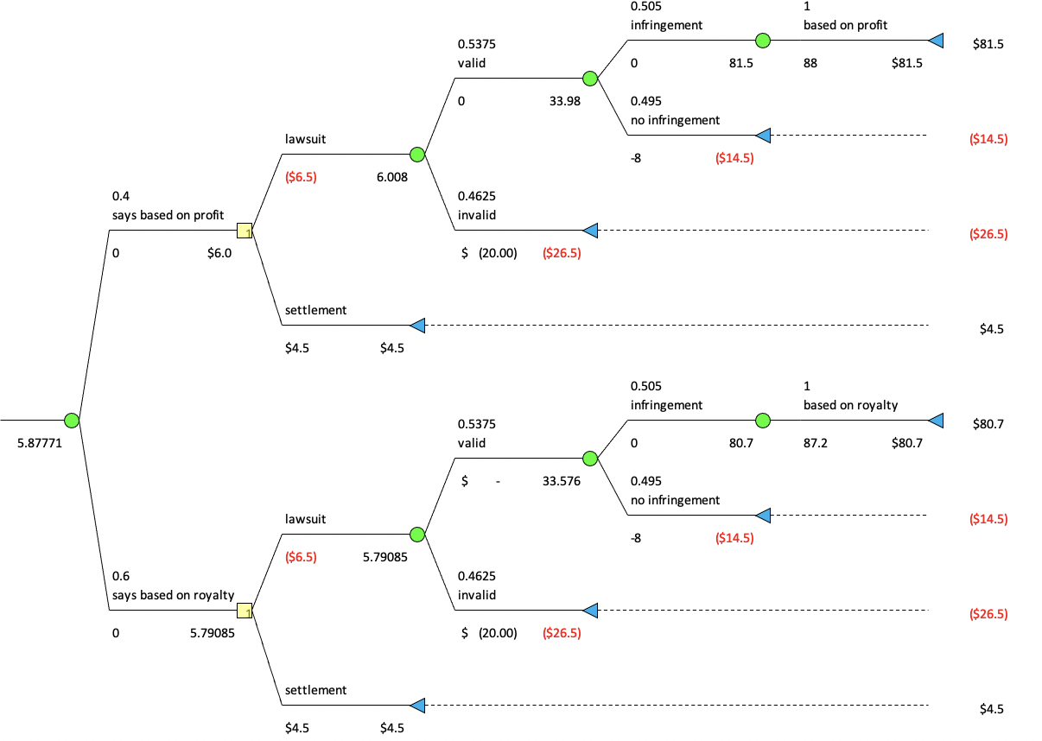
EVPI
Profit vs Royalties: $0M
Notes:
If Energizer’s razor is found to have infringement on Gillette’s product, we will have damage awards been paid based on either profit or royalty. However, information telling which award will we get almost have no value and we should not buy this information because the expected value of profit and royalties are very close to each other giving nearly no value to the information.

Slide 17
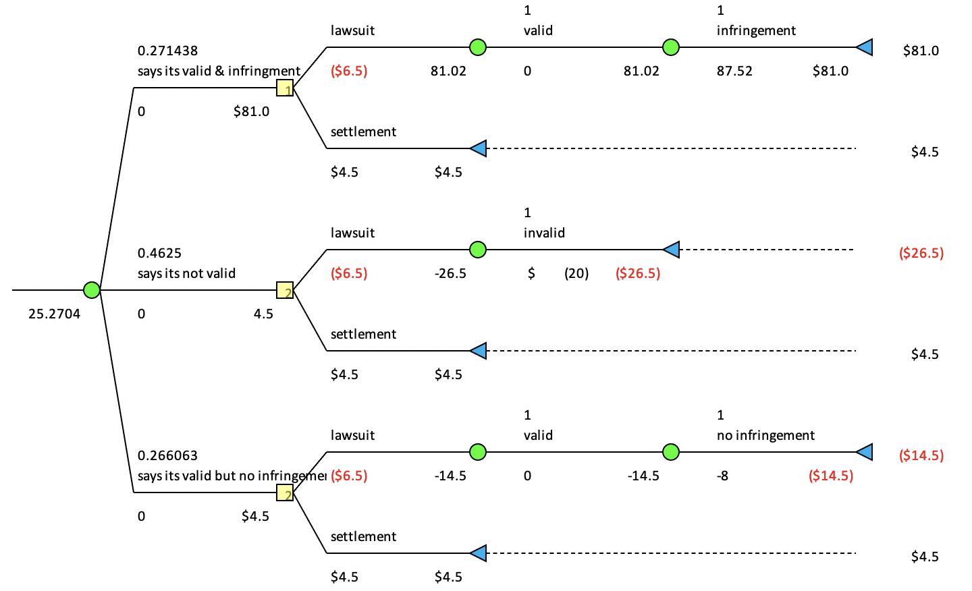
EVPI
Validity and infringement: $19.4M
Notes:
In addition to the single piece of perfect information, we also examined the condition of two pieces of perfect information telling us the result for both patent validity and infringement. If credible sources tell that patent is valid and there is infringement, then Gillette should continue with lawsuit with an expected value of 81 million dollars. Otherwise, Gillette should just accept the settlement. These two pieces of information combined will worth 19.4 million dollars.

Slide 18
Value of Information
Perfect information
Information collection
Very hard to get perfect information in real life
Study and analyze past cases
Bribe the judge (may cause other legal issues)
Notes:
However, it is very hard to get perfect information in real life, most likely we can just do research on past cases of similar intellectual property lawsuits, or do some study to increase our probability of winning. Maybe we can bribe the judge to get certain results, but the money we spent should be less than the expected value of information we discussed just now. And doing that maybe lead to some more legal issues. With that in mind, my teammate Karry will continue to explain what are some values of imperfect information.

Slide 19
Value of Information
Imperfect Information

Slide 20
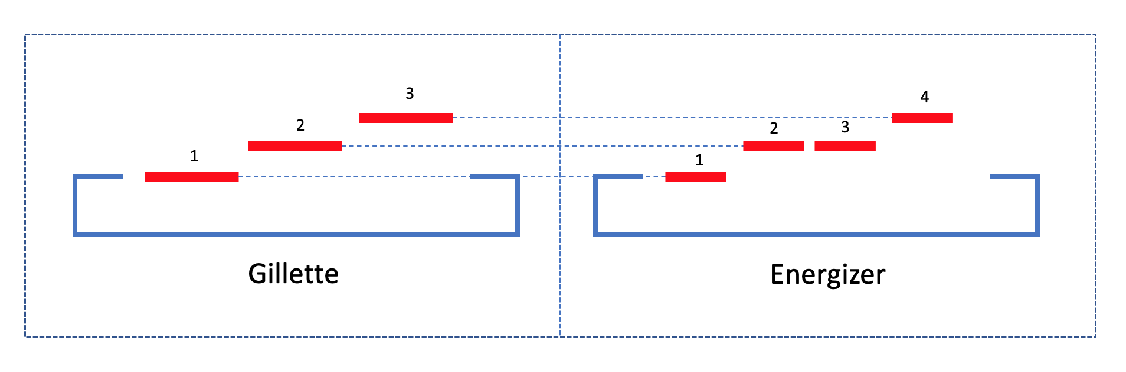
EVSI
Imperfect Information: Scenario
Product Research & Customer Survey (Energizer’s four-blade design)
Goal: To examine similarity in functionality: what is the functionality of Energizer’s 3rd blade, whether the same heights between 2nd and 3rd blades actually makes difference in functionality comparing to Gillette’s three-blades design.
Methodology: The study consists of anonymously and randomly surveying Energizer’s users, and testing and examining from the perspectives of industrial design and ergonomics.
Functional Similarity: Element b established | Functional Difference: Element b fail to be established
Same Configuration: 2rd & 3rd
Same/Differ Configuration: 2rd & 3rd
3rd Blade No Functionality
3rd Blade Has Specified Functionality
Razor Essentially Utilizes 3 Blades
Razor Utilizes 4 Blades
Notes:
Element b from Doctrine of Equivalent requires functional similarity between our product and Energizer’s razor, so that we can proceed to conclude that Energizer is violating the patent law. The lawyers were concerning about establishment of element b given Energizer’s razor has one more blade than our product. And they assigned 50-50 probability of element b being established.
With VOI, we can increase the expected value of proceeding with lawsuit.
Suppose Gillette were to conduct product research/survey on the four-blade design and its functionality. The study consists of anonymously and randomly surveying Energizer’s user, and testing and examining from the perspectives of industrial design and ergonomic. The aim is to find similarity in functionality and question whether the same heights between second and third blades actually makes difference in functionality.
For example:
The study result may suggest that Energizer’s third blade, which is at the same configuration (height, angle, material) as the second blade, does not actually increase the performance razor. Putting it another way, the third blade does not catch any hair when shaving because it was hidden behind the second blade and lower than the fourth blade.
Therefore, though there is one more blade than Gillette’s patented design, the functionality is fairly the same, which both utilize 3 blades to shave. The conclusion would indicate that Energizer did not make any advancement in the blade design but keeping the same functionality of Gillette’s design.

Slide 21
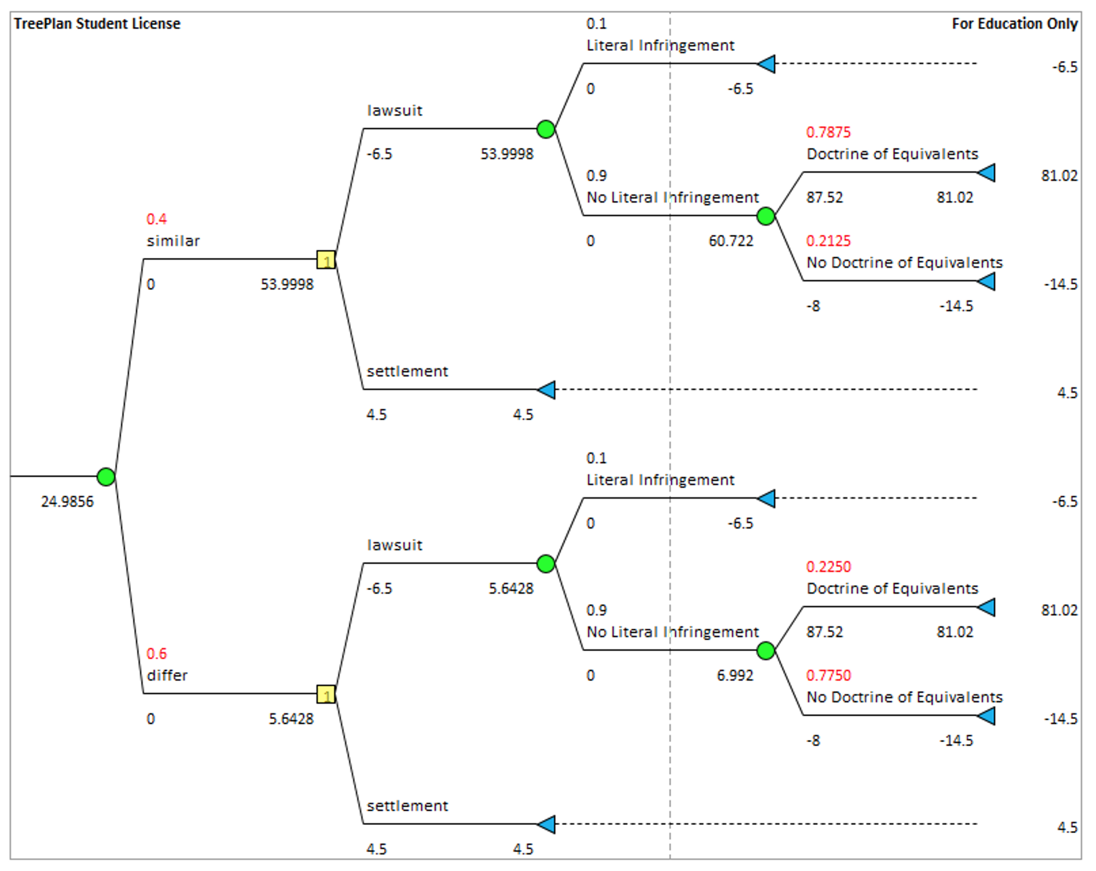
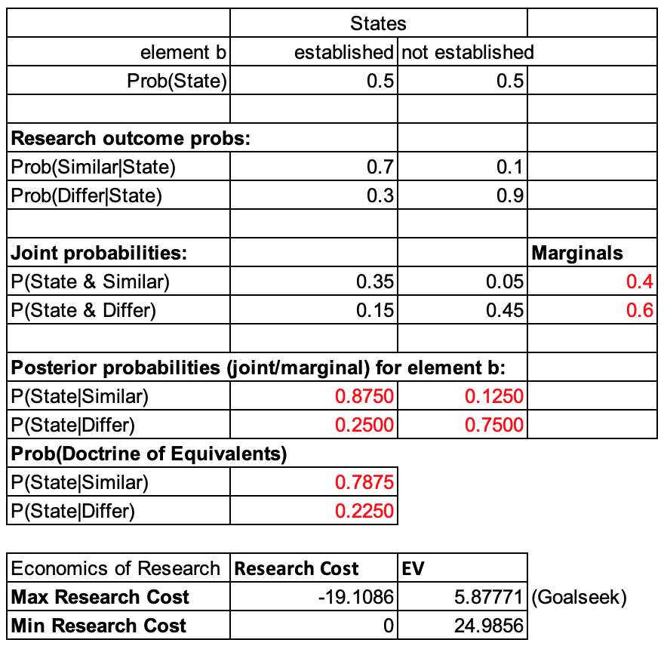
EVSI
Imperfect Information: Decision Tree Illustration
Max EVSI of Product Research = 19.11
Notes:
Assume the probability of element b being established given the product research shows functional similarity is 0.7, and the probability of element b not being established given functional similarity is 0.1. The posterior probabilities of element b being established are then 0.88 and 0.25. Given probability of element a being established is 1 and element c being established is 0.9, the probabilities of Doctrine of Equivalents being established are then 0.79 and 0.23 depending on the product research result.
The use of product research significantly increases the probability of Doctrine of Equivalents being established. Meanwhile, if the research shows functional similarity between Gillette and Energizer’s razors, the expected value is significantly larger than not having the product research.
Gillette also needs to consider the cost of conducting such research study. Given the expected value of research showing ‘differ’ (non functional similarity) is already below 5.88, therefore the budget of such research need to be carefully contained. Also, the total expected value (with sample information) has to be larger than 5.88, otherwise there is no point to conduct such research. Therefore, the maximum budget we can assign to the research is 19 million. However, the higher the cost, the more accurate the research may be, so ideally we also need a sensitivity analysis on the balance between budget and accuracy. For example, a 10 million research may yield prob(Similar|Established) for 0.9 and prob(Similar|Not Established) for 0.05. Yet, a 1 million research would only yield prob(Similar|Established) for 0.6 and prob(Similar|Not Established) for 0.3. Given the hypothetical-ness/lack of information of this consideration, we are not including it here. But it should be something to consider under realistic scenario.

Slide 22
Utility Analysis

Slide 23
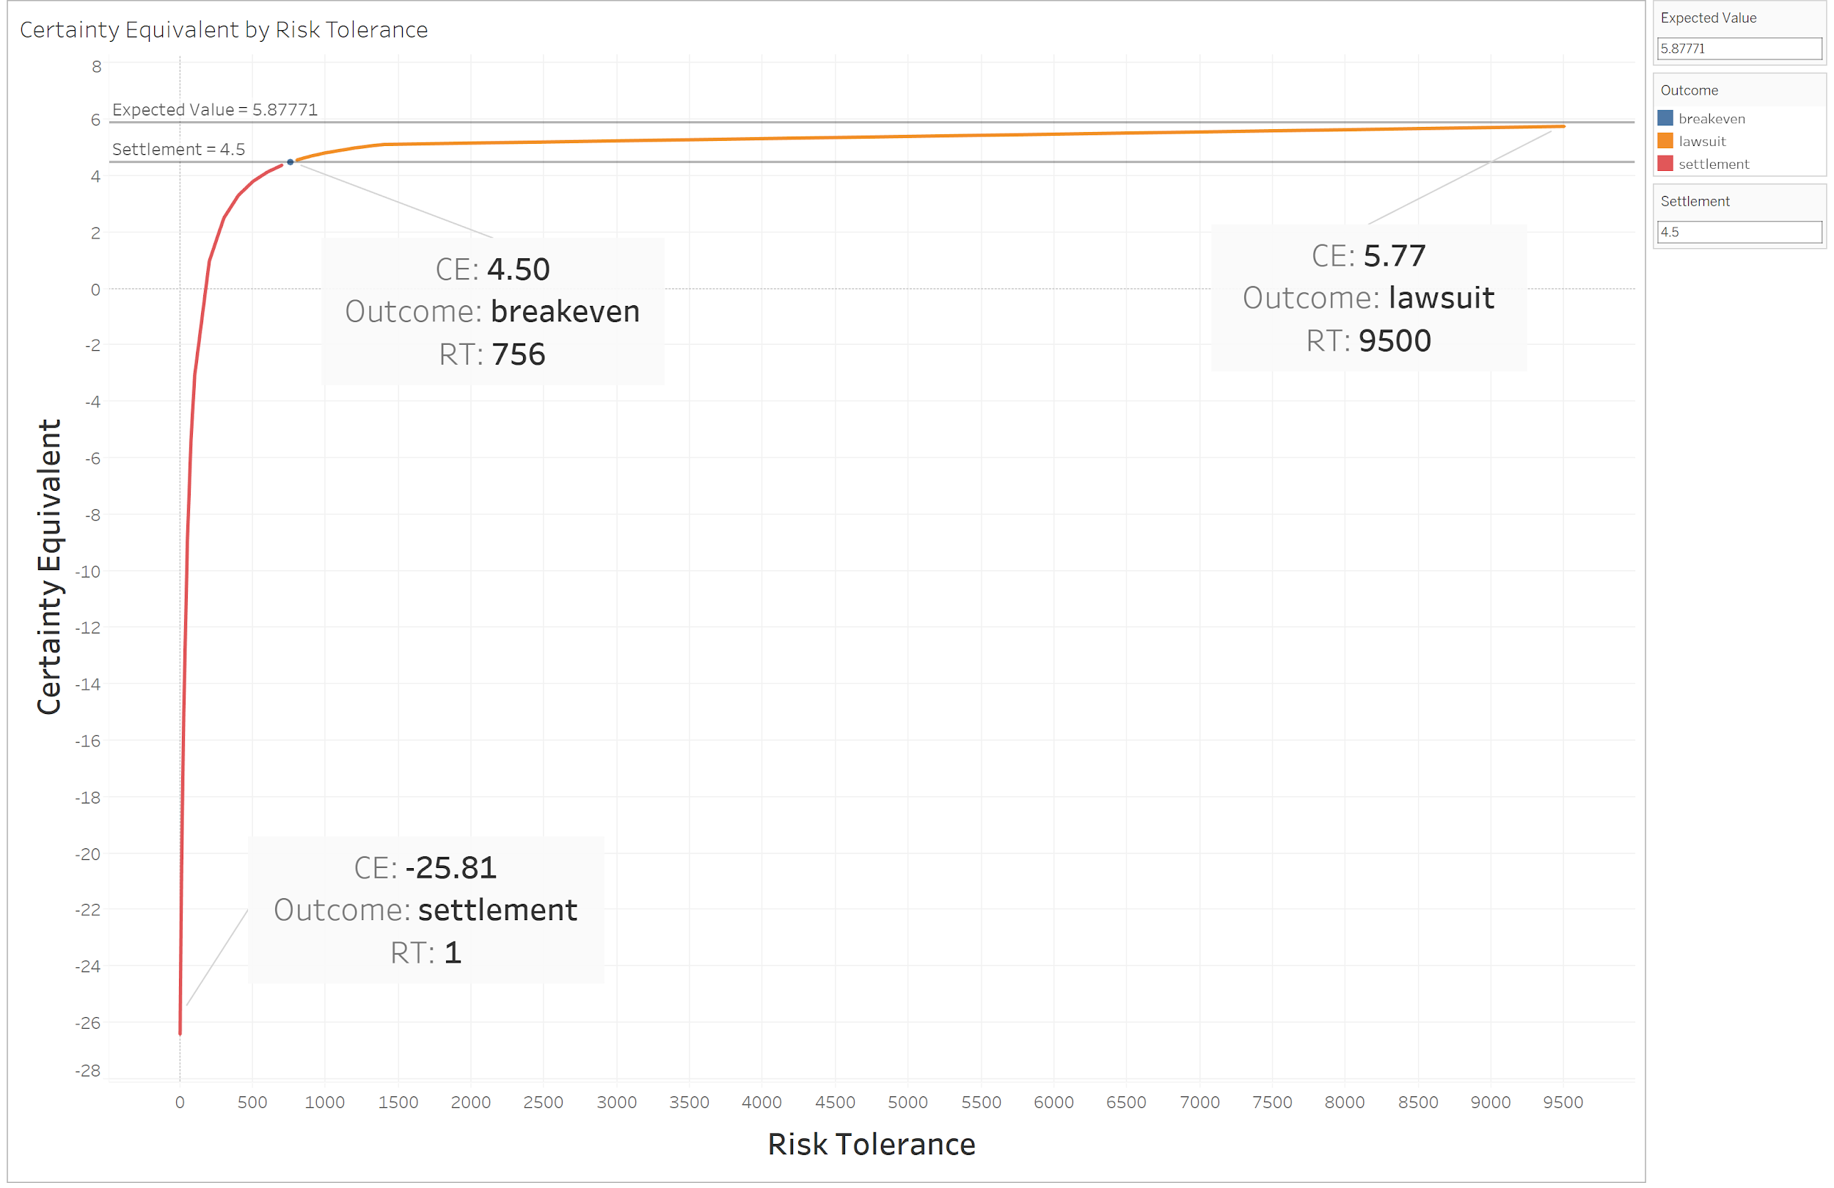
Utility Analysis
Breakeven Risk Tolerance
Notes:
With the current value projections for the lawsuit, Energizer’s settlement offer of $4.5 million gives Gillette a breakeven risk tolerance of around $756 million.
If a corporation’s risk tolerance is 1/6th of their market value, then Energizer’s settlement offer gives Gillette an evaluation of $4.536 billion.
That number is far less than the risk tolerance calculated from the market value of Proctor and Gamble’s acquisition of Gillette ($57 billion), which would give Gillette a risk tolerance of $9.5 billion.
For this reason, we believe that the settlement offer is too low for us to consider not continuing with the lawsuit.
At a market value of $57 billion, the settlement offer would need to be around $5.77 million (the certainty equivalent) for us to be indifferent between the two options.

Slide 24
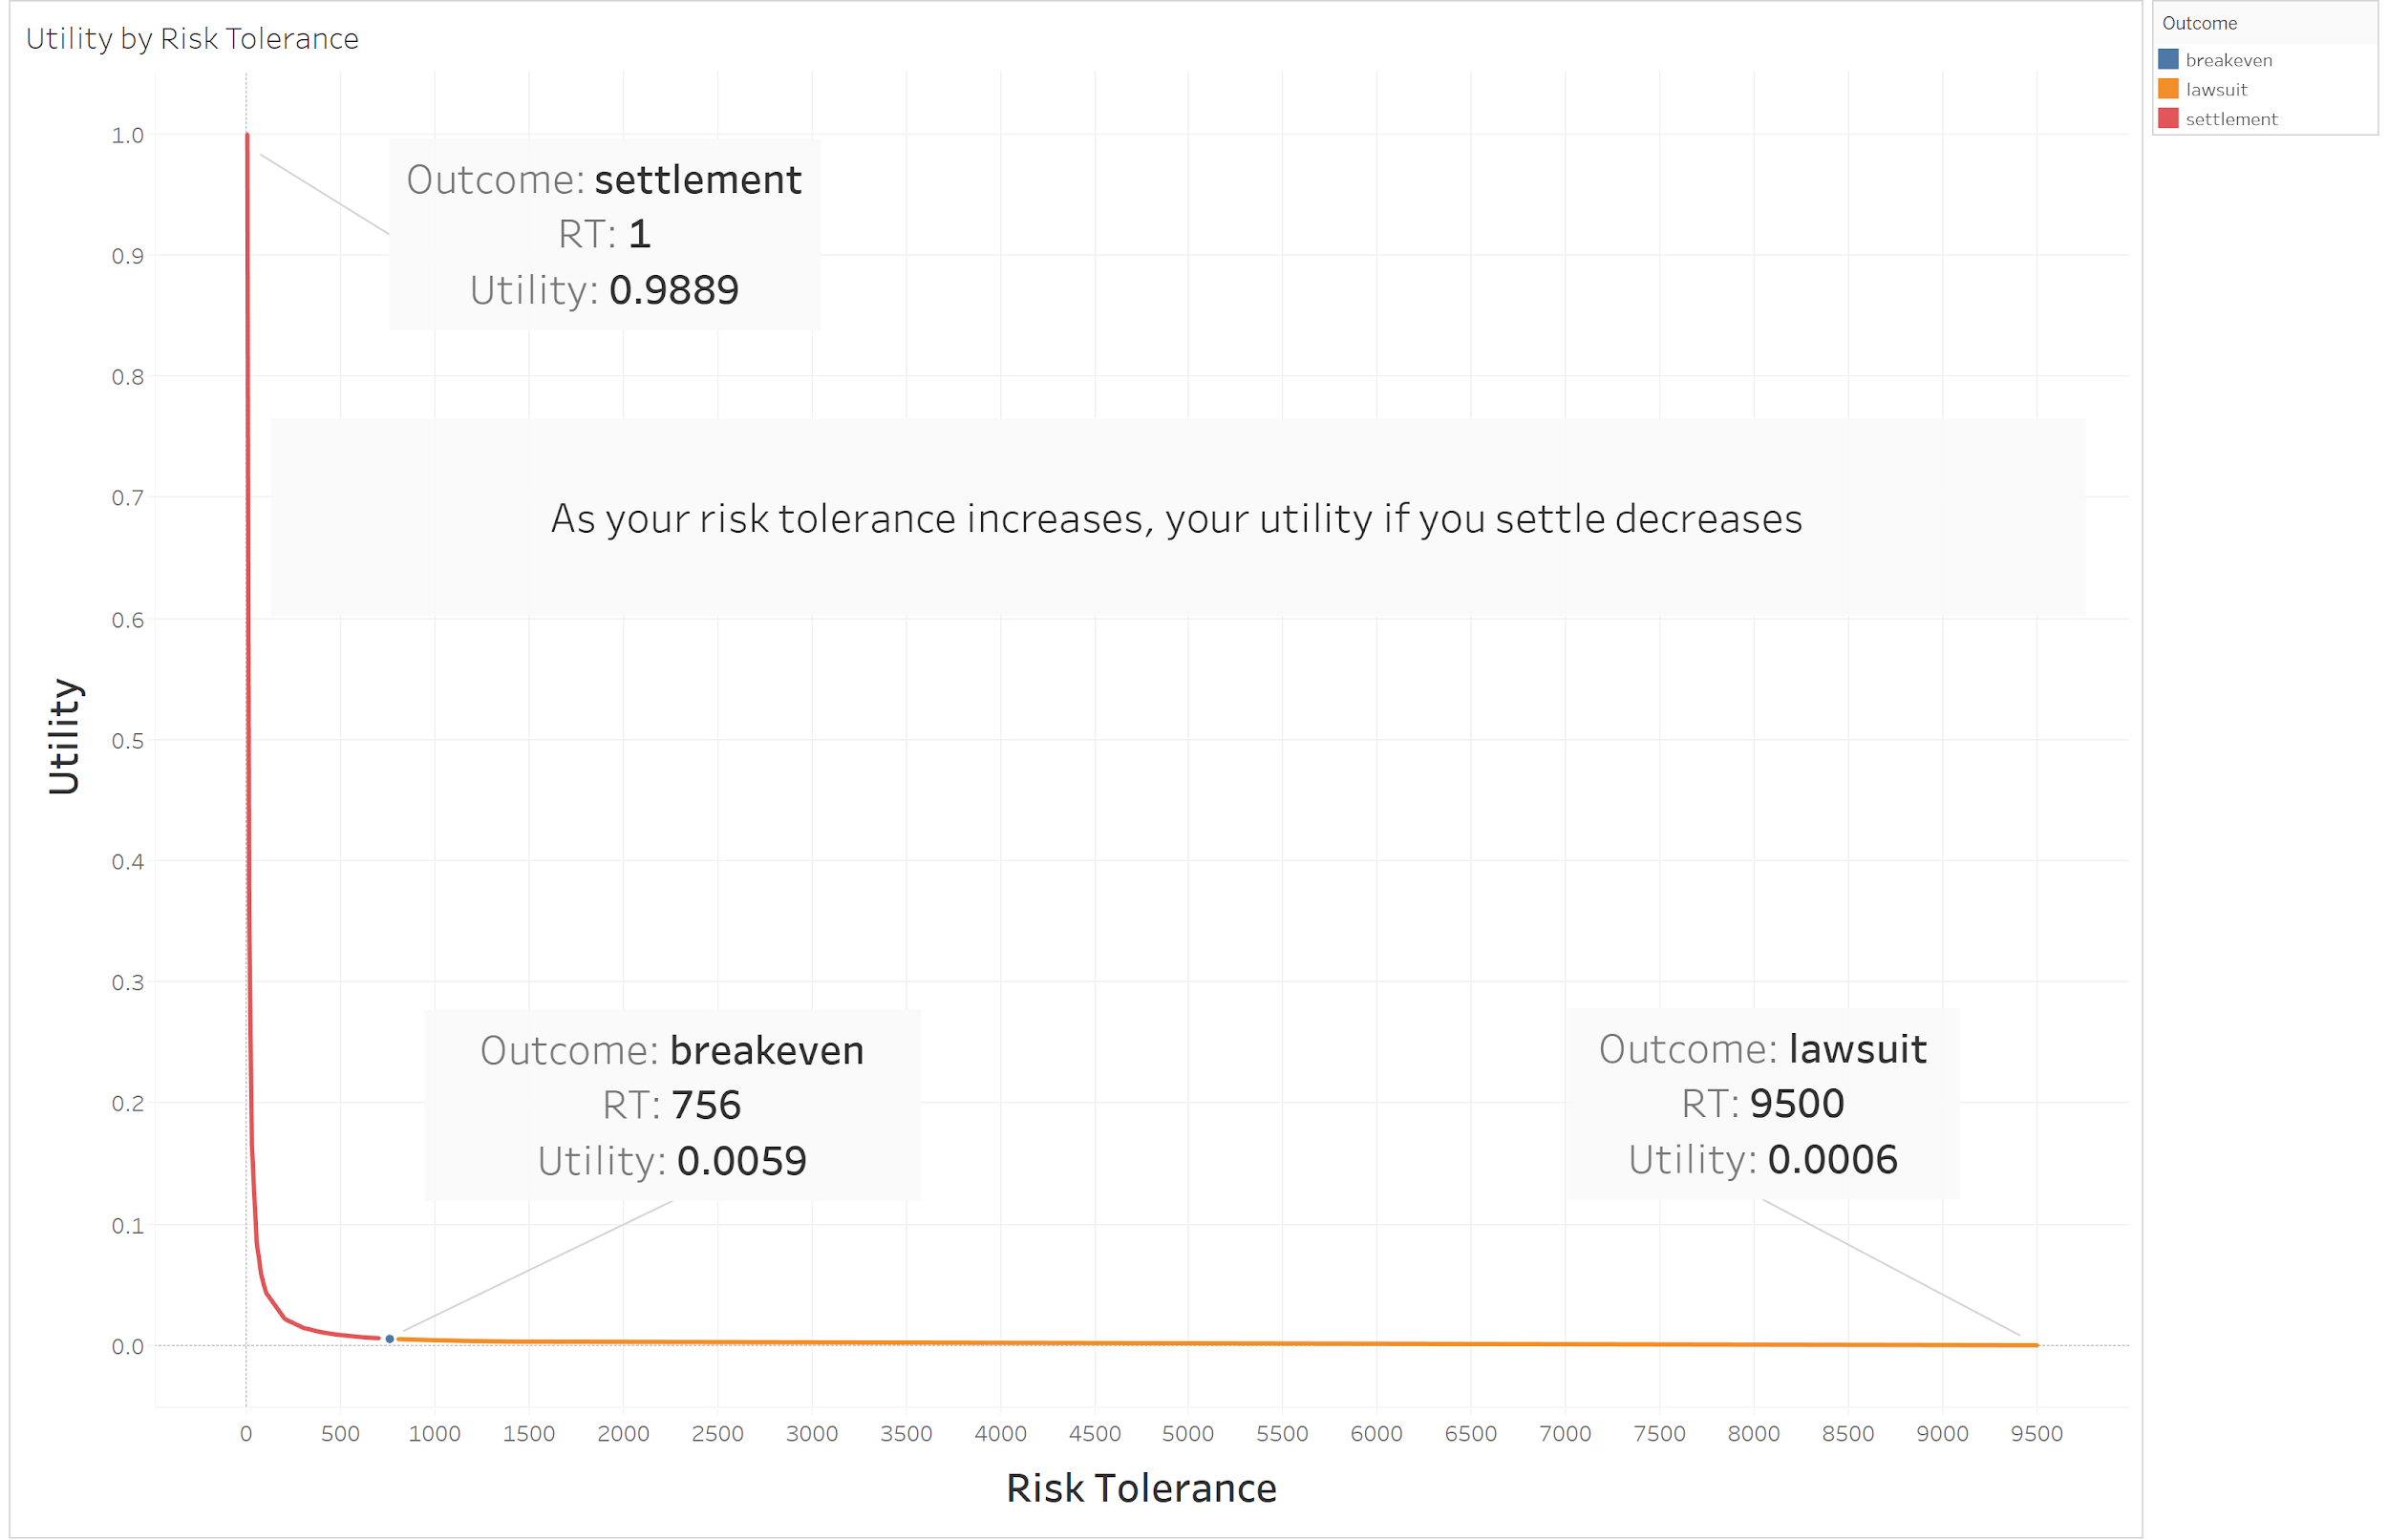
Utility Analysis
Utility by Risk Tolerance
Notes:
As we can see from the graph, the less risk tolerant (or the more risk averse) we are, the higher the utility we gain from taking the settlement offer.
At a risk tolerance of $1 million, we would be almost maxing out our utility.
However, as we become more risk tolerant we become, the utility that we gain plummets, and almost reaches 0 when our risk tolerance is $756 million.
Additionally, we the risk tolerance is $9.5 billion (which was determined by Gillette’s market value), the utility for settling for the $4.5 million offer is essentially 0.

Slide 25
Utility Analysis
Alternate Scenarios
With a risk tolerance of $9.5 billion, the settlement option would be optimal if:
The settlement offer is more than $5.766 million OR
The cost of the lawsuit is more than -$7.766 million OR
The largest loss (valid patent, no infringement) is more than -$27.824 million
Notes:
A couple examples of situations where Gillette would consider switching from the lawsuit to settlement:
The settlement offer is more than $5.766 million (the certainty equivalent for a risk tolerance of $9.5 billion) instead of the $4.5 million offered.
The cost of the lawsuit is more than -$7.766 million instead of the current -$6.5 million projection.
The largest loss despite winning the lawsuit (the patent is found valid, but no infringement found) is more than -$27.824 million instead of the -$12 million projection.

Slide 26
Final Recommendation
Given all our analyses, the expected profit justifies the cost of litigation.

Slide 27
Appendix

Slide 28
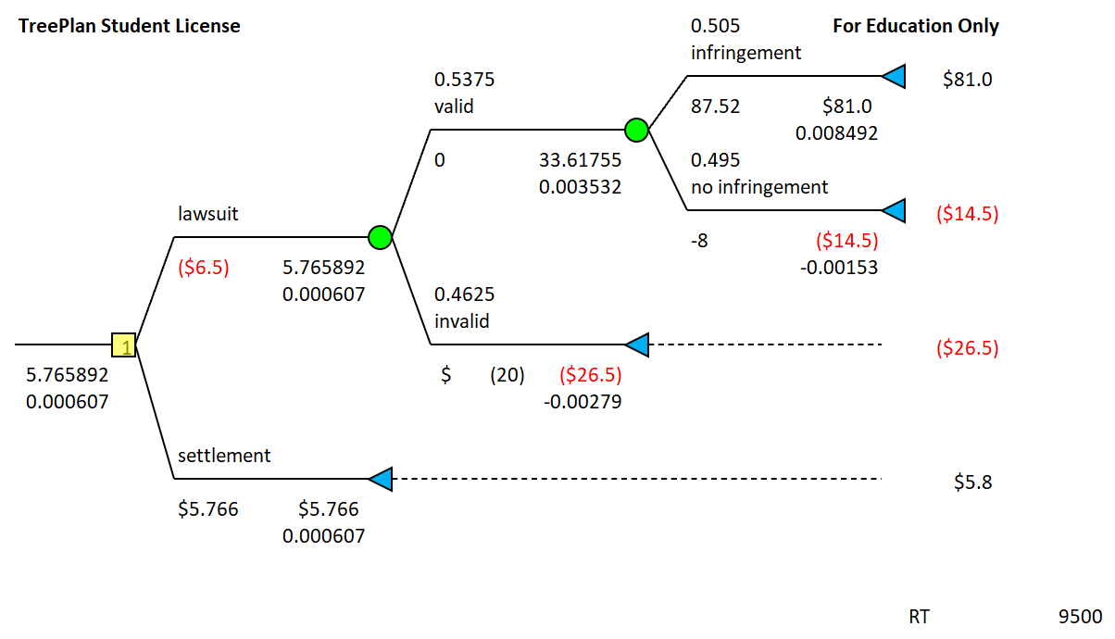
Appendix- Utility Analysis
Alternate Scenarios - Higher Settlement

Slide 29
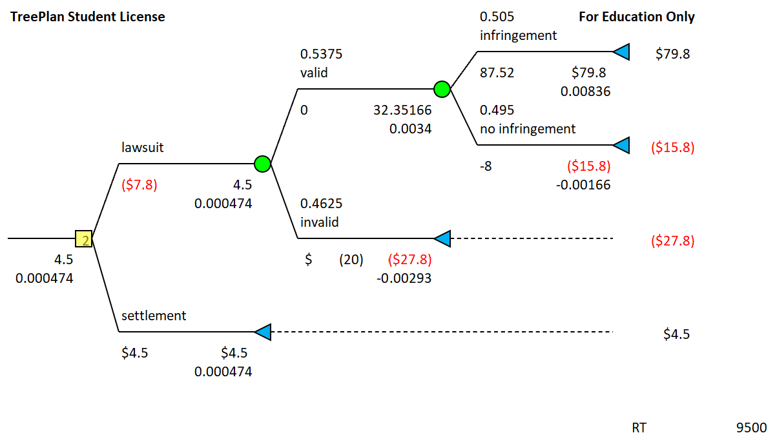
Appendix- Utility Analysis
Alternate Scenarios - Higher Cost of Lawsuit

Slide 30
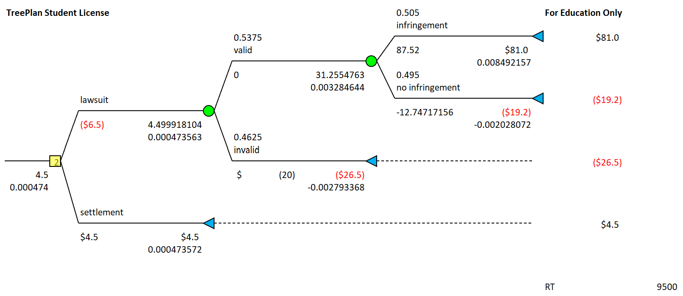
Appendix- Utility Analysis
Alternate Scenarios - Higher Cost of No Infringement Result

